Slide 1

Down The Rabbit Hole
With VMware Automation Config

Slide 2



Christian Mohn
Chief Technologist SDDC | Proact IT Norge AS
VCIX-DCV | vExpert | vNinja.net | @h0bbel
(dropped off the Kahoot! podium)
GitHub
vNinja

Slide 3
What is Aria Automation Configuration?
Spoiler:
It is SaltStack!
(mostly)
A configuration management system
A distributed remote execution system used to execute commands and query data on remote nodes

Slide 4
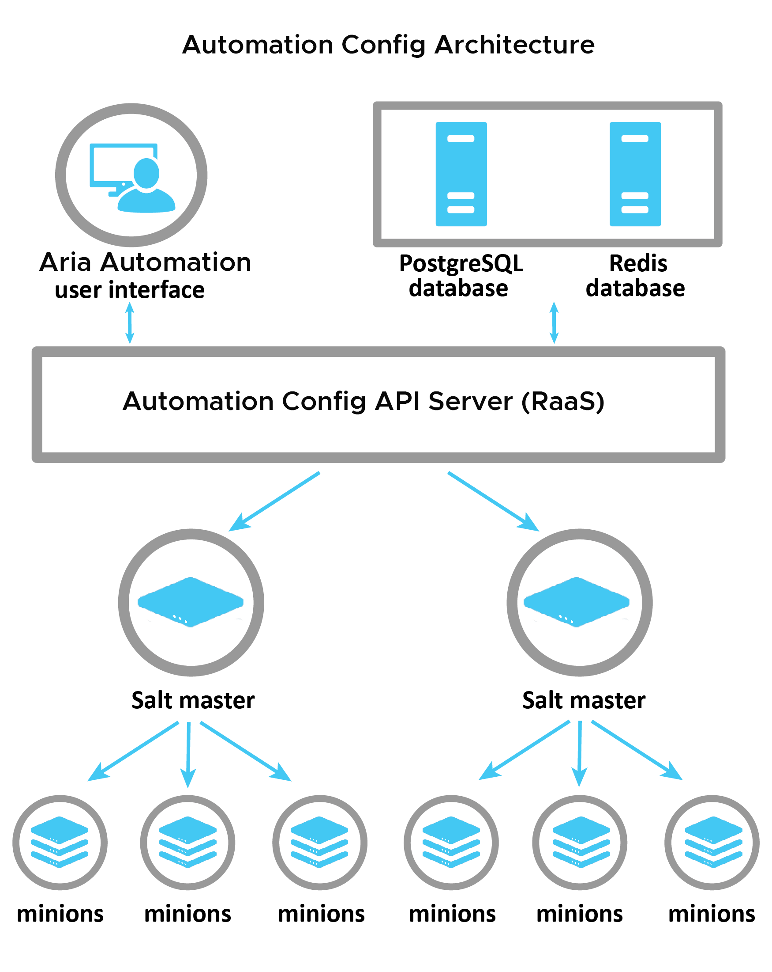
Aria Automation Architecture

Slide 5
Saltstack Concepts
Master — central control bus
Minion — client
States — recipe for minions
Highstate — collection of states
Grains — information from minions
Pillar — information from master to minions (secrets etc.)
Beacons — event monitor for non-salt processes
Reactors — watches salt event bus and reponds

Slide 6
Deploying Aria Automation Configuration
Easy deploy via Aria Suite LifeCycle Manager
— clustering / multi master possible after deployment
Minimum Requirements (up to 5000 minions)
16 vCPU
32 GB RAM
250 GB storage

Slide 7
Minion Requirements
Windows / Linux / MacOS / AIX / Proxy (Napalm+++)
By default looks for salt in DNS (can be configured)
TCP port 4505/4506 from minion to master
All traffic is encrypted

Slide 8
Integration with VMware Tools 12+
VM Options / Advanced / Configuration Parameters / Edit Configuration
guestinfo./vmware.components.salt_minion.desiredstate: present
guestinfo./vmware.components.salt_minion.args: master= ip/hostname
Notes:
vSphere 7 / 01. March 2022
Screenshot?

Slide 9
Tips
Have a test/prod environment
Not just for minions, but also master
If it’s available in Saltstack, it might not be in Aria Automation Config (yet)
Documentation is … scattered
Notes:
Don’t blindly try to configure/install something on the master, by following ”outdated” blog posts. I have broken my installs on several occasions
Not all Saltstack functionality works as you might think; Example gitfs and file server

Slide 10
Live Demo
Notes:
Don’t blindly try to configure/install something on the master, by following ”outdated” blog posts. I have broken my installs on several occasions
Not all Saltstack functionality works as you might think; Example gitfs and file server

Slide 11
Bonus: vSphere Datasets
New in vSphere 8
Datasets are metadata stored with the VM (.dsd)
Only available through vCenter API
Notes:
Introduced in vSphere 8 — Ask if anyone has looked at it?

Slide 12
Bonus: vSphere Datasets
Create dataset in PowerCLI
$vm_moref = "vm-id"
$adminDataSetParam = @{
Name = "salt-ds";
Description = "Dataset for Saltstack";
VMMoref = $vm_moref;
GuestAccess = "READ_ONLY";
HostAccess = "READ_WRITE";
OmitFromSnapshotClone = $false;
}
New-VMDataset @adminDataSetParam
Notes:
Introduced in vSphere 8

Slide 13
Bonus: vSphere Datasets
Set Dataset entry for a VM
$sharedDataSetEntry1Param = @{
Name = "AppID";
VMMoref = "vm-75040";
Dataset = "salt-ds";
Value = "pihole";
}
New-VMDatasetEntry @sharedDataSetEntry1Param
Notes:
Introduced in vSphere 8

Slide 14
Bonus: vSphere Datasets
Readable in the VM through VMware Tools
Can be used to set a grain
vmtoolsd --cmd 'datasets-get-entry {"keys": ["AppID"], "dataset":"salt-ds"}' | jq -r '.entries[].AppID’
pihole
Notes:
Introduced in vSphere 8

Slide 15
Resources
Getting Started with Automation Config saltproject.io
vSphere Datasets
Down The Rabbit Hole GitHub

Slide 16
Christian Mohn
Chief Technologist SDDC | Proact IT Norge AS
VCIX-DCV | vExpert | vNinja.net | @h0bbel
(dropped off the Kahoot! podium)
GitHub
vNinja

Slide 17
Thank you!

